Slide 1
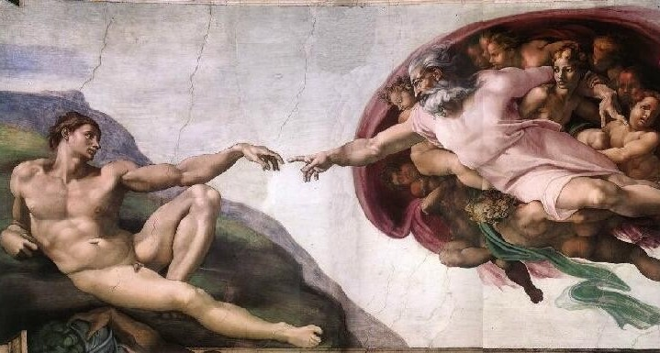
The Existence of God
“What comes into our minds when we think about God is the most important thing about us.”
A. W. Tozer
Notes:
1

Slide 2

Rom. 1:20
For since the creation of the world His invisible attributes, His eternal power and divine nature, have been clearly seen, being understood through what has been made, so that they are without excuse.”

Slide 3

Examining Effects to Discover The Cause
CLUES
Notes:
3

Slide 4
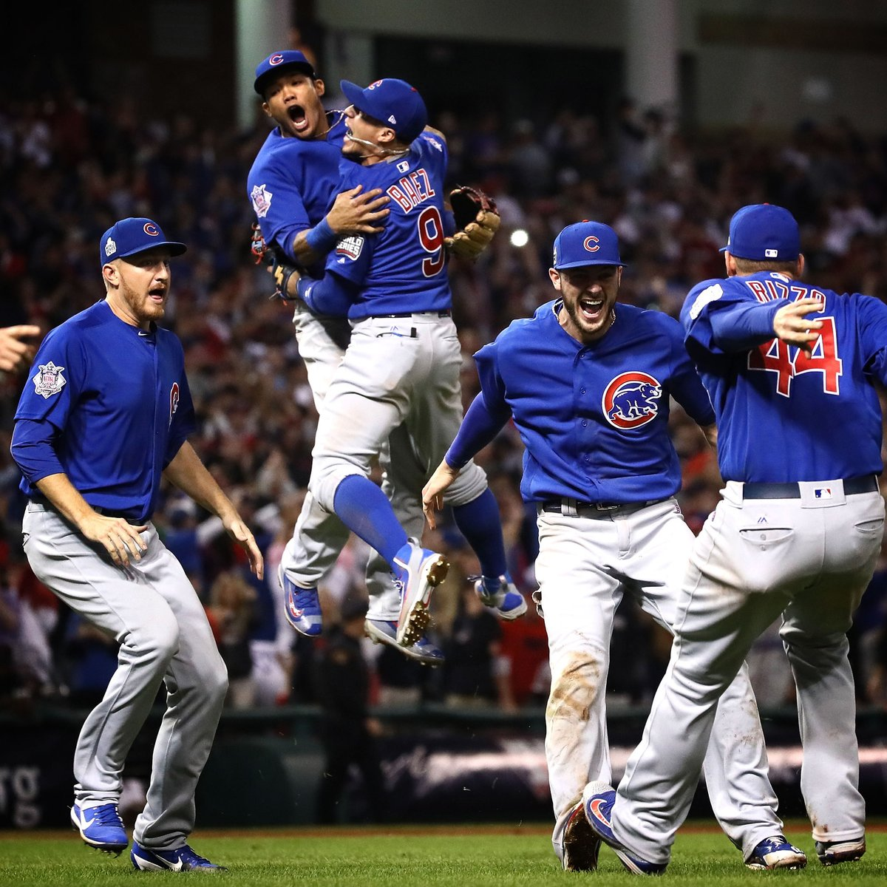
CUBS WIN!

Slide 5
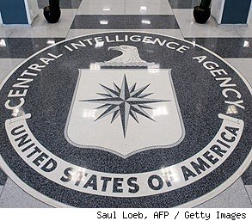
C.I.A.

Slide 6
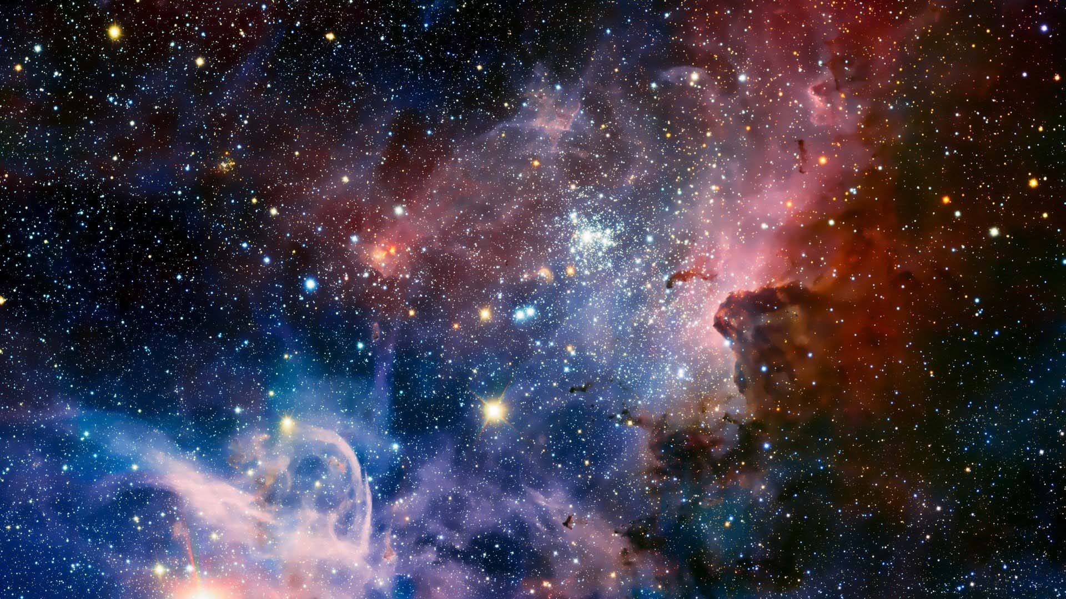
C.I.A.
Cosmological Argument
Intelligent Design Argument
Absolute Moral Values Argument

Slide 7
C.I.A.
Cosmological Argument
Intelligent Design Argument
Absolute Moral Values Argument

Slide 8
Cosmological Argument
Kalam or Horizontal Argument
1. Everything that had a beginning had a cause.
2. The universe had a beginning.
3. Therefore, the universe had a cause.

Slide 9
Cosmological Argument
1. Everything that had a beginning had a cause.
The Law of Causality
All of science depends on this law!

Slide 10
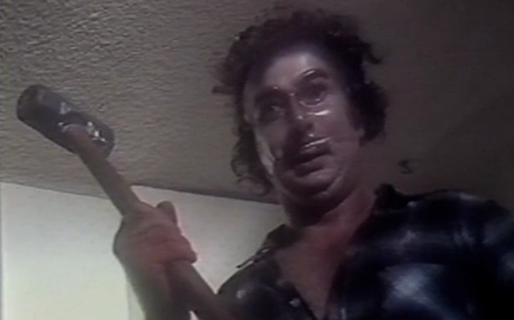

Cosmological Argument
1. Everything that had a beginning had a cause.
CAUSE
EFFECT

Slide 11
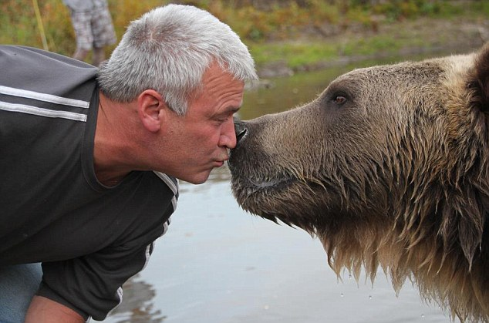
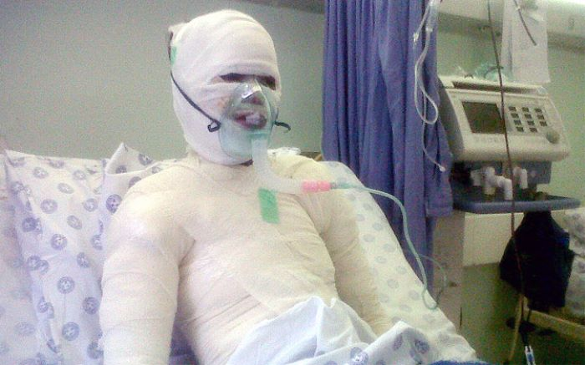
Cosmological Argument
1. Everything that had a beginning had a cause.
CAUSE
EFFECT

Slide 12
Cosmological Argument
1. Everything that had a beginning had a cause.
“Allow me to tell you that I never asserted so absurd a proposition as that anything might arise without a cause.” – David Hume
“Nothing comes from nothing, nothing ever could.” – Julie Andrews

Slide 13
Cosmological Argument
Note:
We are not saying “everything needs a beginning” or “everything needs a cause.”
We are only saying “everthing that begins needs a cause.”

Slide 14
Cosmological Argument
Kalam or Horizontal Argument
1. Everything that had a beginning had a cause.
2. The universe had a beginning.
3. Therefore, the universe had a cause.

Slide 15
Cosmological Argument
2. The universe had a beginning.
Scientific Arguments:
S – Second Law of Thermodynamics
U – Universe Expanding

Slide 16
Cosmological Argument
S – Second Law of Thermodynamics
The amount of usable energy decreases and
things, therefore, run down and move toward
disorder in a closed system.

Slide 17
UNUSABLE
ENERGY

Slide 18
Cosmological Argument
S – Second Law of Thermodynamics
If the universe is running out of useable energy, then it must have had a beginning (since it is not possible to run out of an infinite amount of energy.)

Slide 19
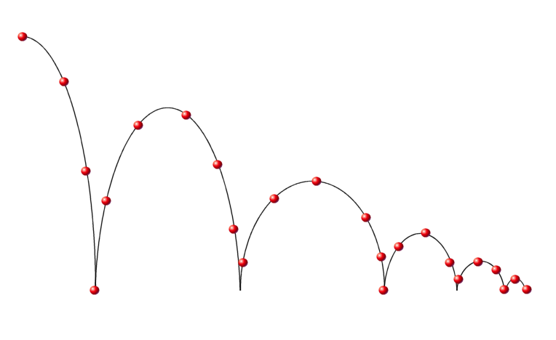
Cosmological Argument
S – Second Law of Thermodynamics
.

Slide 20
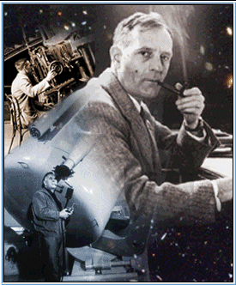
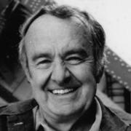
Cosmological Argument
U – Universe Expanding
1929 Edwin Hubble discovered
galaxies are moving away from
each other.
Alan Sandage confirmed that
The universe is expanding.

Slide 21
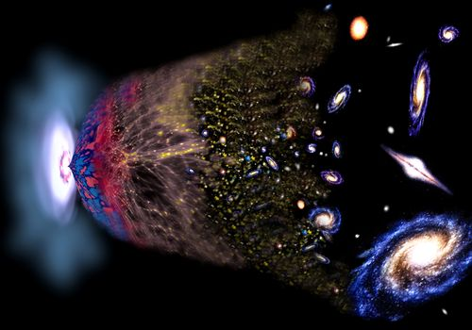
Cosmological Argument
*These findings suggest that if we trace the universe back
it shrinks back to a beginning from nothing.

Slide 22
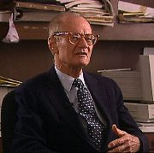
Cosmological Argument
2. The universe had a beginning.
“Science has proven that
the universe exploded into
being at a certain moment.”
(Jastrow, God and the Astonomers)

Slide 23
Cosmological Argument
2. The universe had a beginning.
“The universe began from a state of infinite
density . . . . Space and time were created in
that event and so was all matter in the
universe.”
(Gott, Gunn, Schramm, Tinseley, “Will the
Universe Expand Forever?” Scientific American)

Slide 24
Cosmological Argument
Kalam or Horizontal Argument
1. Everything that had a beginning had a cause.
2. The universe had a beginning.
3. Therefore, the universe had a cause.

Slide 25
Cosmological Argument
3. Therefore, the universe had a cause.
“That there are what I or
anyone would call super-
natural forces at work is
now, I think, a scientifically
proven fact.”
(Jastrow)

Slide 26
Cosmological Argument
The Cause must be Eternal, Infinite,
All-Powerful, Supernatural, Personal

Slide 27
C.I.A.
Cosmological Argument
Intelligent Design Argument
Absolute Moral Values Argument

Slide 28
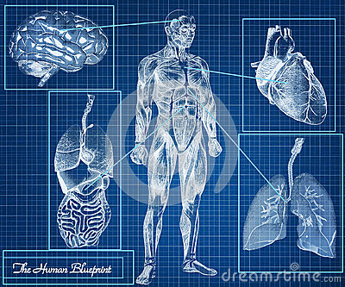
Intelligent Design
What It Ain't!

Slide 29
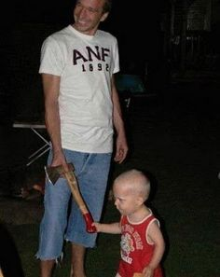

Slide 30
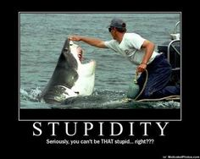

Slide 31
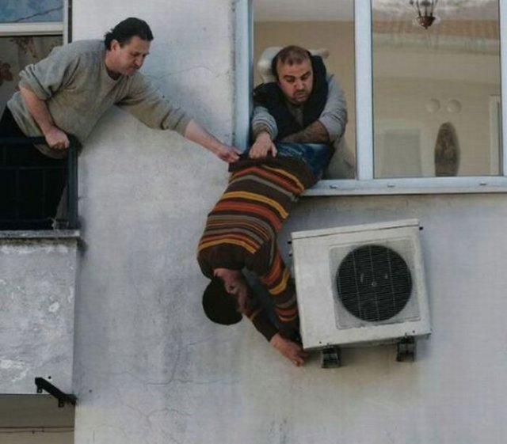

Slide 32


Slide 33
Intelligent Design
What It Is
1. Every design has a designer.
2. The universe and life has
complex design.
3. Therefore, there is a Designer.

Slide 34
Intelligent Design
What It Is
1. Every design has a designer.
2. The universe and life has
complex design.
3. Therefore, there is a Designer.

Slide 35
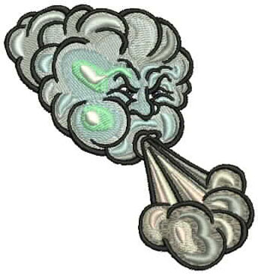

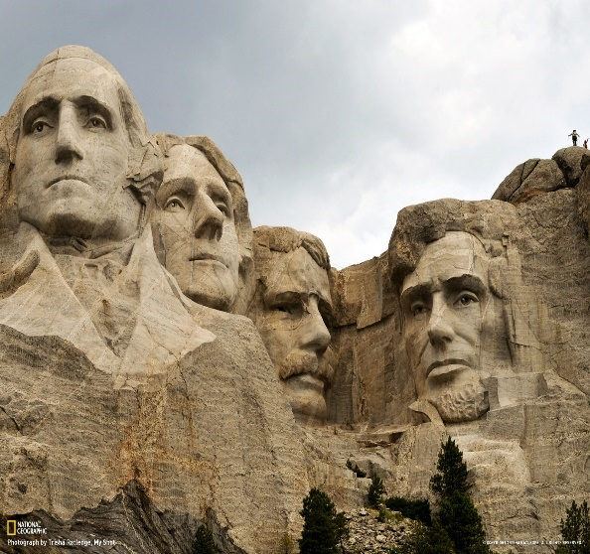
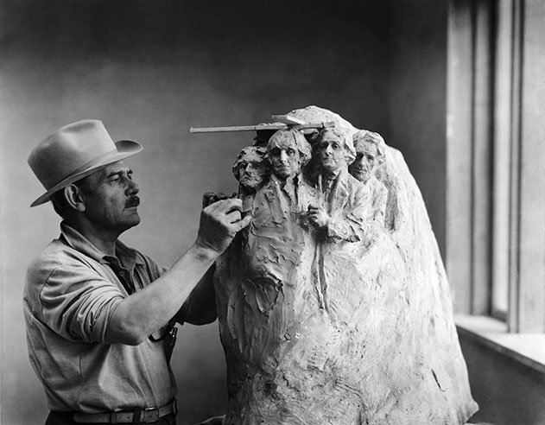
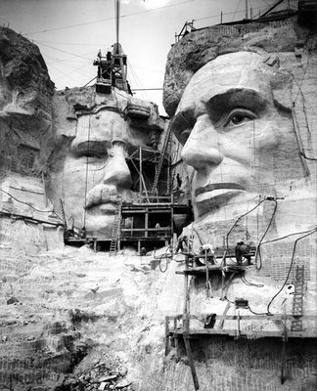
I.D. Every design has a designer.
Natural Forces
+
=
/
INTELLIGENT MIND
+
=

Slide 36
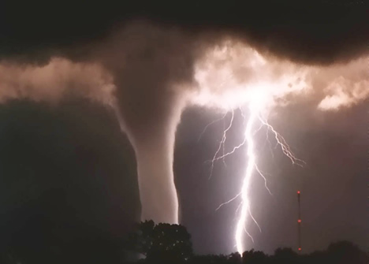

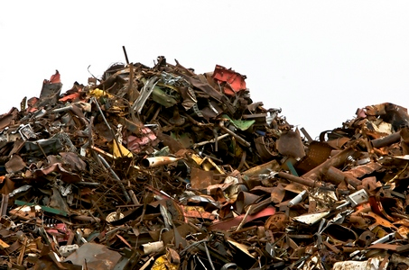
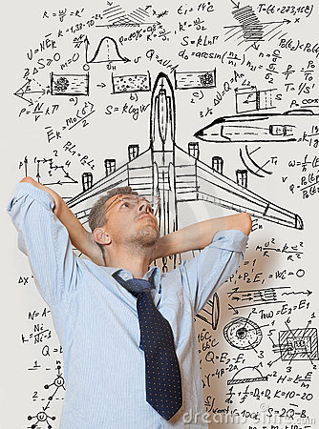
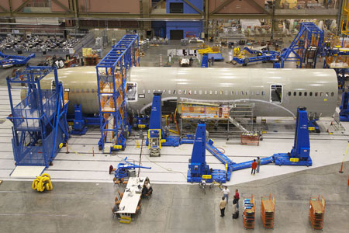
I.D. Every design has a designer.
Natural Forces
+
=
/
INTELLIGENT MIND
+
=

Slide 37
Intelligent Design
What It Is
1. Every design has a designer.
2. The universe and life has
complex design.
3. Therefore, there is a Designer.

Slide 38
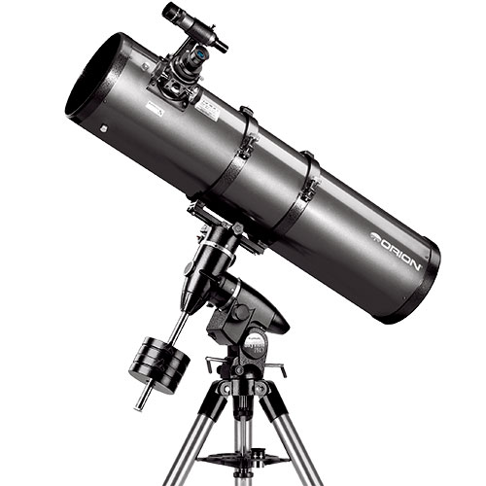
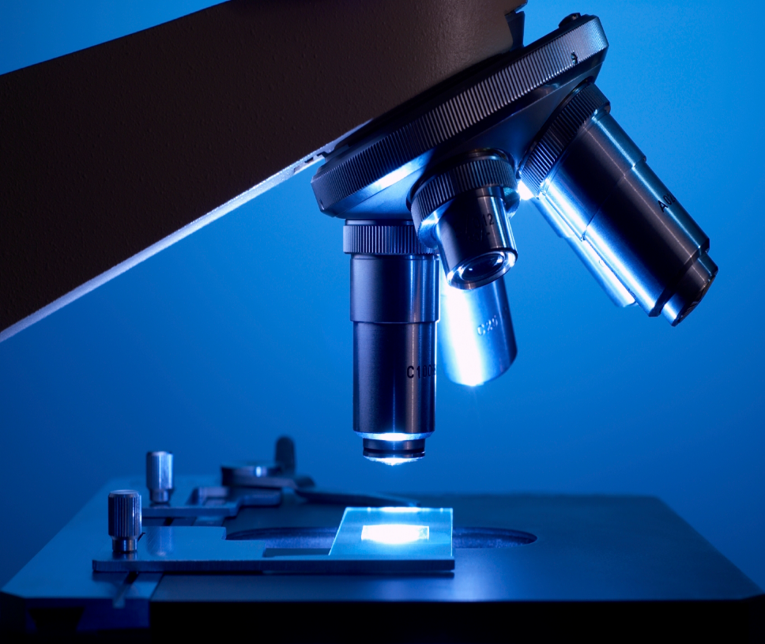
I. D. 2. The universe and life has
complex design.
The Telescope
The Microscope

Slide 39
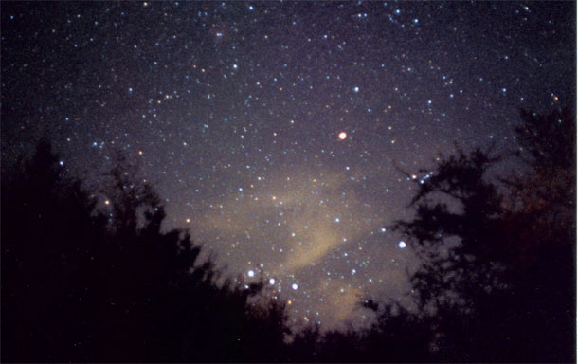
The Telescope
The Anthropic Principle – The universe has been fine-tuned
for the existence of life in general and human life in particular.
Conditions needed to make life possible are vastly improbable.
Concept Model - # seconds in history of universe = 10¹⁸
Concept Model - # of subatomic particles in universe = 10⁸⁰
Cosmologist Donald Page calculates that the odds
of our universe existing as 1 in 10,000,000,000¹²⁴

Slide 40
The Telescope
Fine-Tuning
(See Jay Richard’s “List of Fine-Tuning Parameters”)
Cosmic Constants
Gravitational force constant - too weak, planets and stars cannot form; to strong, stars burn up too quickly. By one estimate, if we increased strength of gravity by 1 part in 10³⁴, no sustaining planets.
Electromagnetic force constant - much stronger or weaker, no stable chemical bonds.
Strong nuclear force constant - if weaker, far fewer stable chemical elements including many essential for life
Weak nuclear force constant – much stronger or weaker, life-essential stars couldn’t form.
Cosmological constant – balance of attractive force of gravity with hypothesized repulsive force in space. Fine tuned to 1 part in 10¹²⁰. Slightly more positive, universe flies apart; slightly negative; universe collapses.

Slide 41
The Telescope
Fine-Tuning
Initial Conditions and “Brute Facts”
(6) Initial distribution of mass energy – physicist Roger Penrose estimates that the odds of the initial low entropy (highly ordered energy) state of our universe occurring by chance alone are on the order of 1 in 10¹⁰⁽¹²³⁾.
(7) Ratio of masses for protons and electrons
(8) Velocity of light
(9) Mass excess of neutron over proton

Slide 42
The Telescope
Fine-Tuning
“Local” Planetary Conditions
10. 21 % oxygen in air is just right for human life.
25%=fires; 15%=suffocation
11. Goldie Locks Zone of earth in the solar system
12. Goldie Locks Zone for our solar system in the galaxy
13. Deep within earth's interior the movement of liquid iron generates an outer protective magnetic field around earth's atmosphere which prohibits solar winds from stripping away the earth's atmosphere. If earth were much smaller, the magnetic field would be too weak.

Slide 43
The Telescope
Fine-Tuning
14. Tilt of the earth offers the best condition for life. Otherwise surface temperature differences would be too great.
15. The position of Jupiter and Saturn protects life on earth.
16. Rotation rate of earth is optimal. Much longer than 24 hours = temperature differences too great between day and night; much shorter than 24 hours = atmospheric wind velocities would be too great.

Slide 44
The Telescope
Fine-Tuning
Stephen Hawking has admitted:
"The remarkable fact is that the values of these numbers [the constants of physics] seem to have been very finely adjusted to make possible the development of life."
(A Brief History of Time, p. 125)

Slide 45
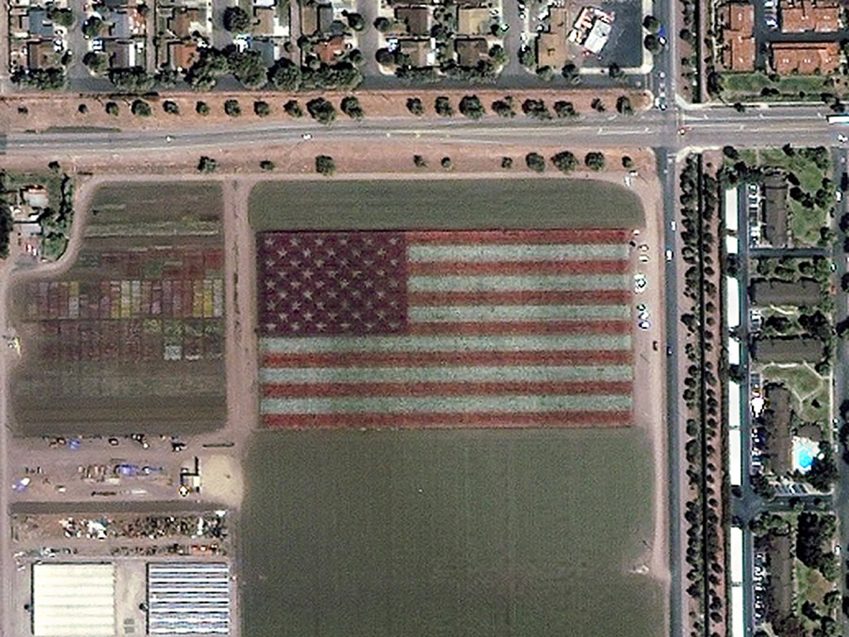
What are the chances it formed by colored confetti falling from the sky?

Slide 46
What are the chances it formed by colored confetti falling from the sky?
What if the confetti was taken higher and had more time to fall?

Slide 47
Intelligent Design
What It Is
1. Every design has a designer.
2. The universe and life has
complex design.
3. Therefore, there is a Designer.

Slide 48
C.I.A.
Cosmological Argument
Intelligent Design Argument
Absolute Moral Values Argument

Slide 49
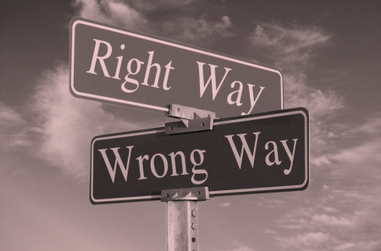
ABSOLUTE Moral Values
Rom. 2:15
“…they [Gentiles] show the works of the
Law written in their hearts, their conscience bearing
witness and their thoughts alternately accusing or
else defending them,…”

Slide 50
ABSOLUTE Moral Values
1. Every law has a lawgiver.
2. There is an absolute moral law.
3. Therefore, there is an absolute
Moral Lawgiver.

Slide 51
ABSOLUTE Moral Values
1. Every law has a lawgiver.
2. There is an absolute moral law.
3. Therefore, there is an absolute
Moral Lawgiver.

Slide 52

Every law has a lawgiver.
Customer: “Can I have some drugs?!
I've got a prescription.”
Pharmacist: “Who prescribed it?”
Customer: “No one. It's just a prescription.”

Slide 53
ABSOLUTE Moral Values
1. Every law has a lawgiver.
2. There is an absolute moral law.
3. Therefore, there is an absolute
Moral Lawgiver.

Slide 54
There is an Absolute Moral Law (AML).
1. Moral absolutes are self-evident (innate.)
a. Morality is “a natural inclination” (Aquinas, ST)
b. Everyone has heard people quarreling (Lewis, MC)
1) “That’s my seat. I was there first.”
2) “How would you like it if someone did that to you?”
3) “Give me some of your cookie. I gave you some of
mine.”
4) “Leave him alone. He isn’t hurting you.”
5) “Come on, you promised.”
*All of these people are appealing to a standard of behavior
that they expect the other person(s) to understand.

Slide 55
There is an Absolute Moral Law (AML).
1. Moral absolutes are self-evident (innate.)
c. People may make excuses for breaking the
“standard,” but rarely to they reject it.
d. Making excuses insinuates that one
recognizes one’s accountability to the
standard.

Slide 56
There is an Absolute Moral Law (AML).
1. Moral absolutes are self-evident (innate.)
2. Moral absolutes are unavoidable.
3. No moral progress is possible without
AML.
4. No moral judgments are valid without AML.
5. Without AML, all moral judgments are merely
opinion.
6. Those who deny moral absolutes betray their
view in their own lives!

Slide 57
There is an Absolute Moral Law (AML).
7. Good questions to draw out the moral law within:
* What person does not expect to be treated as
a person?
*Who ever actually believed that murder, rape, or cruelty
to children was morally right (or indifferent)?
*Who ever actually believed that it was right to take what
belonged to anyone at any time?
*Do you really believe there is nothing wrong anywhere?

Slide 58
ABSOLUTE Moral Values
1. Every law has a lawgiver.
2. There is an absolute moral law.
3. Therefore, there is an absolute
Moral Lawgiver.

Slide 59
ABSOLUTE Moral Values
The Best, If Not The Only, Option For
An Absolute Moral Lawgiver Is God.
Hence, if there has ever been anything
truly good or truly evil, God must exist.

Slide 60
C.I.A.
Cosmological Argument
Intelligent Design Argument
Absolute Moral Values Argument

Slide 61
What comes into your mind when you think about God?
God must Exist -- Universe is caused and designed, and the absolute nature of morality requires it.
God’s Attributes -- Eternal, Infinite, Supernatural, All-Powerful, Immaterial Creator who has Designed a universe with such precision so as to reveal His Genius and Wisdom; He’s a Personal Being who is the very ground of Goodness.
The revelation doesn’t stop here!

